Slide 1
AI Application Problem
(ri_ReLU_sro)
Data
Input
x1 | 性別
x2 | 年齡
x3 | 國籍
x4 | 婚姻狀態
x5 | 直系親屬數
x6 | 最高學歷
x7 | 來台時長
x8 | 平均月收入
x9 | 剩餘居留時間
Input
x10 | 借款時長
x11 ​ | 借款金額 ​
x12 ​ | 用途
x13​ | 工作性質
x14​ | 工作地點​
x15​ | 雇主資訊​
x16 ​ | 薪資如期撥入 ​
x17 ​ | 薪資撥付方式​
x18​ | 薪資結匯方式​
Output
風險評估 | 為百分制，分數越高，違約的可能性越高

Slide 2
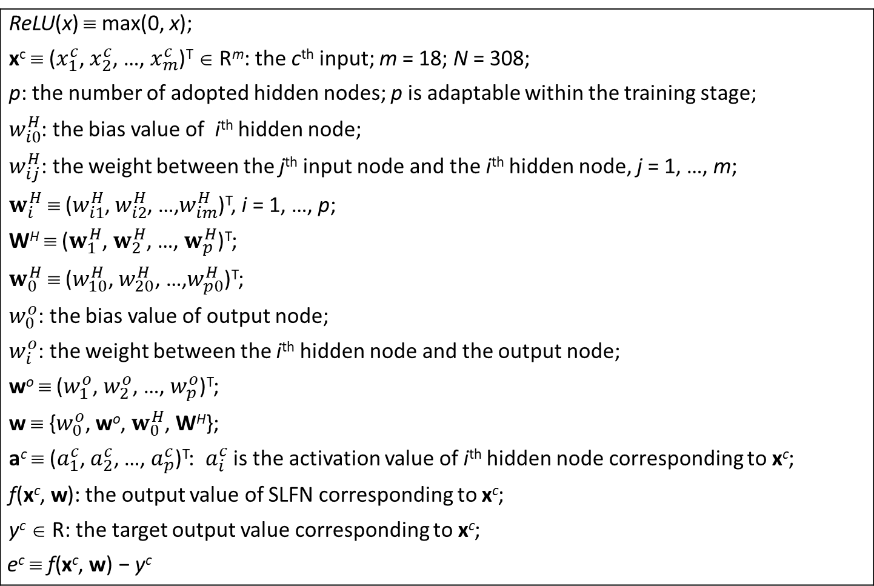
Assumption: the adaptive network
The network setting:
Two-layer nets / SLFN / One-hidden-layer nets
ReLU(x) ≡ max(0, x); x^{c} ≡ ($x_{1}^{c}$, $x_{2}^{c}$, …, $x_{m}^{c}$)^{T} ∈ R^{m}: the c^{th} input; m = 18; N = 308; p: the number of adopted hidden nodes; p is adaptable within the training stage; $w_{i0}^{H}$: the bias value of i^{th} hidden node; $w_{ij}^{H}$: the weight between the j^{th} input node and the i^{th} hidden node, j = 1, …, m; $w_{i}^{H}$ ≡ ($w_{i1}^{H}$, $w_{i2}^{H}$, …,$w_{im}^{H}$)^{T}, i = 1, …, p; W^{H} ≡ ($w_{1}^{H}$, $w_{2}^{H}$, …, $w_{p}^{H}$)^{T}; $w_{0}^{H}$ ≡ ($w_{10}^{H}$, $w_{20}^{H}$, …,$w_{p0}^{H}$)^{T}; $w_{0}^{o}$: the bias value of output node; $w_{i}^{o}$: the weight between the i^{th} hidden node and the output node; wº ≡ ($w_{1}^{o}$, $w_{2}^{o}$, …, $w_{p}^{o}$)^{T}; w ≡ {$w_{0}^{o}$, wº, $w_{0}^{H}$, W^{H}}; a^{c} ≡ ($a_{1}^{c}$,${ a}_{2}^{c}$, …, $a_{p}^{c}$)^{T}: $a_{i}^{c}$ is the activation value of i^{th} hidden node corresponding to x^{c}; f(x^{c},$\text{w}$): the output value of SLFN corresponding to x^{c}; y^{c} ∈ R: the target output value corresponding to x^{c}; $$\text{e}\text{c} \text{≡ }\text{f}\text{(}\text{x}\text{c}\text{,} \text{w}\text{)}\text{ − }\text{y}\text{c}$$

Slide 3

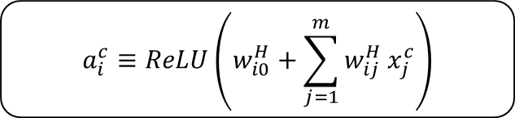



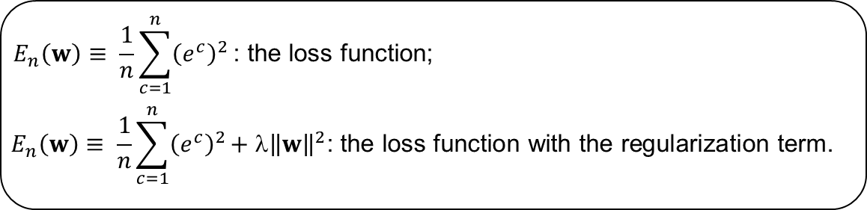
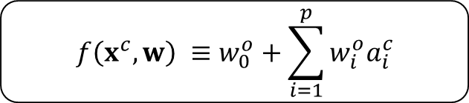
The forward operation.
Forward operation
Hidden Layer
The hidden layer:
i
$$a_{i}^{c}≡\operatorname{ReLU}\left(w_{i0}^{H}+\sum_{j=1}^{m}{w_{ij}^{H}}x_{j}^{c}\right)$$
Input Layer
$$x_{1}$$
$$x_{2}$$
$$x_{3}$$
…
$$x_{m}$$
Output Layer
The output layer:
1
$$f\left(x^{c},w\right) ≡w_{0}^{o}+\sum_{i=1}^{p}{w_{i}^{o}a_{i}^{c}}$$
Hidden Layer
1
2
…
p
$$E_{n}\left(w\right)≡ \frac{1}{n}\sum_{c=1}^{n}{{\left(e^{c}\right)}^{2}}\text{: }\text{the} \text{loss} \text{function}\text{;}$$
$$E_{n}\left(w\right)≡ \frac{1}{n}\sum_{c=1}^{n}{{\left(e^{c}\right)}^{2}}\text{+ }\text{λ}{\left\|w\right\|}^{2}\text{: }\text{the} \text{loss} \text{function} \text{with} \text{the} \text{regularization} \text{term}\text{.}$$
Notes:
The Single-hidden layer Feedforward Neural Networks (SLFN) structure

Slide 4


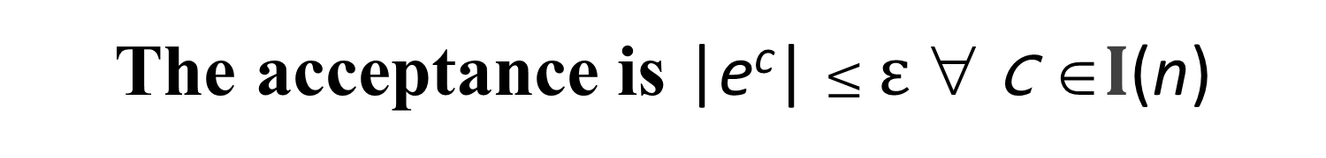
The learning goal of the n^{th} stage
learning goal:
|e^{c}| ≡ |$f\left(x^{c},w\right)$- $y^{c}$| ≤ $\text{ε}$ ∀ c ∈$I$(n)
inferencing goal:
|$f\left(x^{c},w\right)$- $y^{c}$| ≤ $\text{ε}$ ∀ c ∈$I($N)
The acceptance is |e^{c}| $≤\text{ε}$ ∀ c ∈$I$(n)

Slide 5
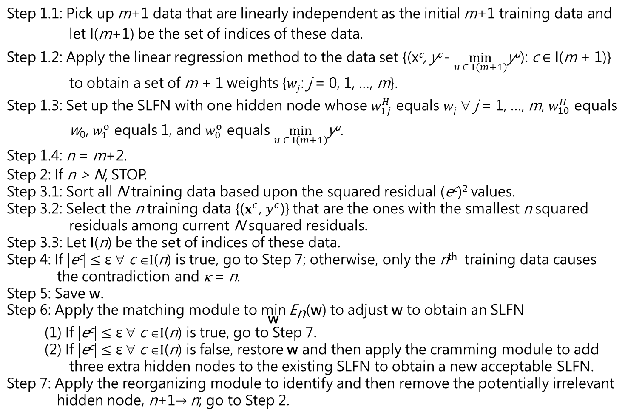
The proposed learning algorithm
Step 1.1: Pick up m+1 data that are linearly independent as the initial m+1 training data and let I(m+1) be the set of indices of these data. Step 1.2: Apply the linear regression method to the data set {(x^{c}, y^{c} - $\min_{u ∈ I\left(m+1\right)}$y^{u}): c ∈ I(m + 1)} to obtain a set of m + 1 weights {$wj$: j = 0, 1, …, m}. Step 1.3: Set up the SLFN with one hidden node whose $w_{1j}^{H}$ equals $wj$ ∀ j = 1, …, m, $w_{10}^{H}$ equals w₀, $w_{1}^{o}$ equals 1, and $w_{0}^{o}$ equals $\min_{u ∈ I\left(m+1\right)}$y^{u}. Step 1.4: n = m+2. Step 2: If n > N, STOP. Step 3.1: Sort all N training data based upon the squared residual (e^{c})² values. Step 3.2: Select the n training data {($x^{c}$, $y^{c}$)} that are the ones with the smallest n squared residuals among current N squared residuals. Step 3.3: Let I(n) be the set of indices of these data. Step 4: If |e^{c}| $≤\text{ε}$ ∀ c ∈$I$(n) is true, go to Step 7; otherwise, only the n^{th} training data causes the contradiction and κ = n. Step 5: Save w. Step 6: Apply the matching module to $\underset{\text{w}}{\text{min}}{{\text{E}}_{\text{n}}\text{(}\text{w}\text{)}}$ to adjust w to obtain an SLFN (1) If |e^{c}| $≤\text{ε}$ ∀ c ∈$I$(n) is true, go to Step 7. (2) If |e^{c}| $≤\text{ε}$ ∀ c ∈$I$(n) is false, restore w and then apply the cramming module to add three extra hidden nodes to the existing SLFN to obtain a new acceptable SLFN. Step 7: Apply the reorganizing module to identify and then remove the potentially irrelevant hidden node, n+1$→$n; go to Step 2.

Slide 6
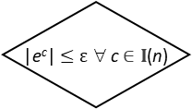

The proposed learning algorithm
(in flowchart)
True
n ≥ N
False
$${LTS}_{n}^{N}$$
|e^{c}| $≤\text{ε}$ ∀ c $∈I$(n)
False
Save w
True
Matching
A
n ++
Reorganizing
Cramming
Restore w
B
Initializing
6

Slide 7

The initializing module
Step 1: Pick up m+1 data that are linearly independent as the initial m+1 training data and let I(m+1) be the set of indices of these data.
Step 2: Apply the linear regression method to the data set {(x^{c}, y^{c} - $\min_{u ∈ I\left(m+1\right)}$y^{u}): c ∈ I(m + 1)} to obtain a set of m + 1 weights {$wj$: j = 0, 1, …, m}.
Step 3: Set up the SLFN with one hidden node whose $w_{1j}^{H}$ equals $wj$ ∀ j = 1, …, m, $w_{10}^{H}$ equals w₀, $w_{1}^{o}$ equals 1, and $w_{0}^{o}$ equals $\min_{u ∈ I\left(m+1\right)}$y^{u}.
Step 4: n = m+2.
In Step 2, the corresponding set of simultaneous linear equations is a system of m + 1 linear equations in m + 1 unknowns:
w₀ + $\sum_{j=1}^{m}{wj{ x}_{j}^{c}}=$ y^{c} - $\min_{u∈ I\left(m+1\right)}$y^{u} ∀ c ∈ I(m + 1)
This setup of SLFN renders (e^{c})² = 0 ∀ c ∈ I(m + 1)

Slide 8


The ${LTS}_{n}^{N}$ module
The stopping criterion
If n > N, STOP.
At the n^{th} stage,
Step 1: Sort all N training data based upon the squared residual (e^{c})² values.
Step 2: Select the n training data {($x^{c}$, $y^{c}$)} that are the ones with the smallest n squared residuals among current N squared residuals.
Step 3: Let I(n) be the set of indices of these data.

Slide 9
The learning goal
|e^{c}| $≤\text{ε}$ ∀ c $∈I$(n)
The save module
Save w
The restore module
Restore the saved w

Slide 10
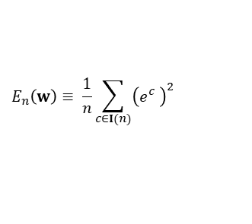
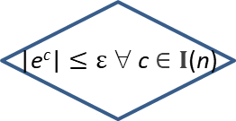
The matching module
Hyperparameters:
100
Optimizer (Adam)
ε = 0.001
$$E_{n}\left(w\right)≡ \frac{1}{n}\sum_{c∈I(n)}{{\left(e_{}^{c}\right)}^{2}}$$
i = 1
i++
forward
operation
False
i ≥ 100
|e^{c}| $≤\text{ε}$ ∀ c $∈I$(n)
backward operation
False
True
True
B
Unacceptable net
Acceptable net
A

Slide 11

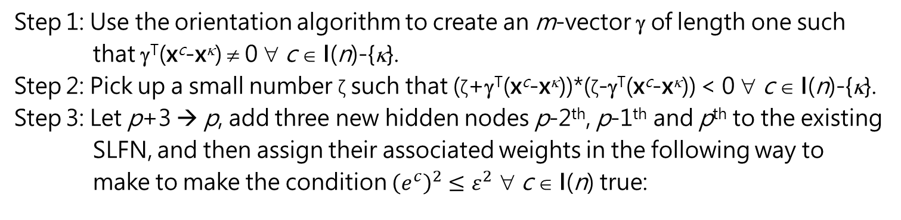
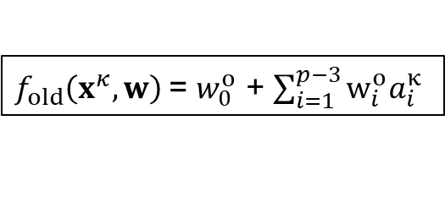
The cramming module
Step 1: Use the orientation algorithm to create an m-vector γ of length one such that γ^{T}(x^{c}-x^{κ}) ≠ 0 ∀ c ∈ I(n)-{κ}.
Step 2: Pick up a small number ζ such that (ζ+γ^{T}(x^{c}-x^{κ}))*(ζ-γ^{T}(x^{c}-x^{κ})) < 0 ∀ c ∈ I(n)-{κ}.
Step 3: Let p+3 → p, add three new hidden nodes p-2th, p-1th and p^{th} to the existing SLFN, and then assign their associated weights in the following way to make to make the condition ${\left(e^{c}\right)}^{2}≤ε^{2}$ ∀ c ∈ I(n) true:
$w_{p−2}^{H}$ = γ, $w_{p−2,0}^{H}$ = ζ-$^{T}x^{κ}$, $w_{p−2}^{o}$ = $\frac{y^{κ}−w_{0}^{o}−\sum_{i=1}^{p−3}{w_{i}^{o}a_{i}^{κ}}}{ζ}$
$w_{p−1}^{H}$ = γ, $w_{p−1,0}^{H}$ = -$^{T}x^{κ}$, $w_{p−1}^{o}$ = $\frac{{−2(y}^{κ}−w_{0}^{o}−\sum_{i=1}^{p−3}{w_{i}^{o}a_{i}^{κ})}}{ζ}$
$w_{p}^{H}$ = γ, $w_{p0}^{H}$ = -ζ-$^{T}x^{κ}$, $w_{p}^{o}$ = $\frac{y^{κ}−w_{0}^{o}−\sum_{i=1}^{p−3}{w_{i}^{o}a_{i}^{κ}}}{ζ}$
$f_{old}\left(x^{κ},w\right)$= $w_{0}^{o}$ + $\sum_{i=1}^{p−3}{w_{i}^{o}a_{i}^{κ}}$

Slide 12
The cramming module
Step 1: Use the orientation algorithm to create an m-vector γ of length one such that γ^{T}(x^{c}-x^{κ}) ≠ 0 ∀ c ∈ I(n)-{κ}.
Step 2: Pick up a small number ζ such that (ζ+γ^{T}(x^{c}-x^{κ}))*(ζ-γ^{T}(x^{c}-x^{κ})) < 0 ∀ c ∈ I(n)-{κ}.
Pick up a small number ζ and then use the random number algorithm to create an m-vector γ of length one such that γ^{T}(x^{c}-x^{κ}) ≠ 0 ∀ c ∈ I(n)-{κ} AND (ζ+γ^{T}(x^{c}-x^{κ}))*(ζ-γ^{T}(x^{c}-x^{κ})) < 0 ∀ c ∈ I(n)-{κ}.
12

Slide 13


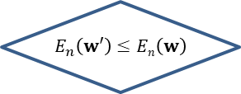
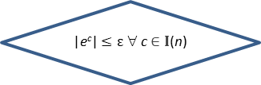


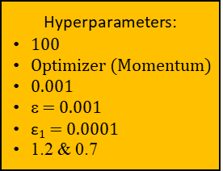
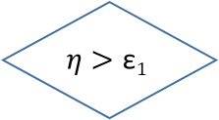

$$E_{n}\left(w\right)≡ \frac{1}{n}\sum_{c∈I(n)}{{\left(e_{}^{c}\right)}^{2}}\text{+}\frac{\text{0.001}}{p+1+p(m+1)}\text{(}\sum_{i=0}^{p}{\text{(}w_{i}^{o}\text{)}\text{2}}\text{ + }\sum_{i=1}^{p}{\sum_{j=0}^{m}{{(w}_{ij}^{H}}\text{)}\text{2}}\text{)}$$
The regularizing module
An acceptable net that accomplishes the learning goal
$$η$$
i = 1
An acceptable net that has a preference on weights
True
i ≥ 100
False
Store w
Hyperparameters:
100
Optimizer (Momentum)
0.001
ε = 0.001
$\text{ε}1$ = 0.0001
1.2 & 0.7
backward operation to obtain $w′$
$w^{′}→w$ $$1.2 η→η$$
i+1 $→$ i
forward operation
Restore w
& $0.7η→η$
$$E_{n}\left(w′\right)≤En\left(w\right)$$
|e^{c}| $≤\text{ε}$ ∀ c $∈I$(n)
True
True
False
False
True
$$η>\text{ε}1$$
False
Restore w
An acceptable net that has a preference on weights

Slide 14
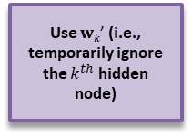
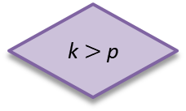
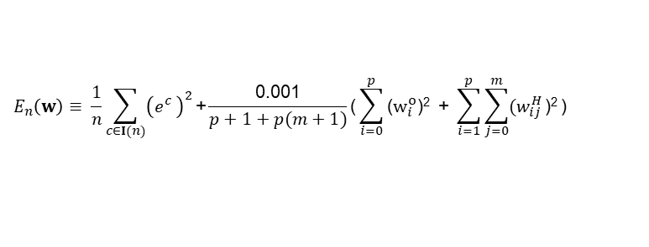


$$E_{n}\left(w\right)≡ \frac{1}{n}\sum_{c∈I(n)}{{\left(e_{}^{c}\right)}^{2}}$$
The reorganizing module
$$E_{n}\left(w\right)≡ \frac{1}{n}\sum_{c∈I(n)}{{\left(e_{}^{c}\right)}^{2}}\text{+}\frac{\text{0.001}}{p+1+p(m+1)}\text{(}\sum_{i=0}^{p}{\text{(}w_{i}^{o}\text{)}\text{2}}\text{ + }\sum_{i=1}^{p}{\sum_{j=0}^{m}{{(w}_{ij}^{H}}\text{)}\text{2}}\text{)}$$
k ++
Restore the network and w
Hyperparameters:
100
Two optimizers (Momentum & Adam)
0.001
Two sets of ε & $\text{ε}1$
(ε = 0.001; $\text{ε}1$ = 0.0001)
Two sets of 1.2 & 0.7
p --
A
B
An acceptable SLFN
k = 1
k $>$p
False
regularizing module
Store the network and w
Use $wk\text{’}$ (i.e., temporarily ignore the $k^{th}$ hidden node)
matching module
True
An acceptable SLFN
Different loss functions!

